Slide 1
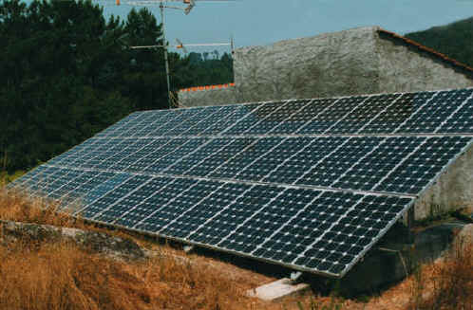

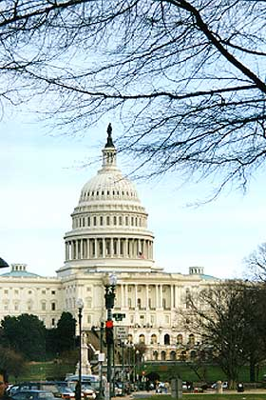
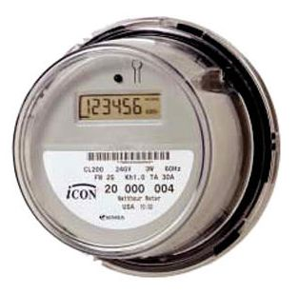
Dynamic Pricing:
Opportunities & Challenges
New England Electric
Restructuring Roundtable
October 28, 2011
Rick Morgan
Commissioner
Public Service Commission
of the District of Columbia

Slide 2
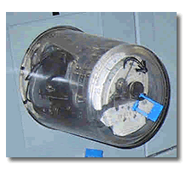
A “revolution” in electricity pricing
‘Dumb’ metering is a century-old technology
  One price for all kWh, tallied monthly
  Traditional retail rate designs blend costs & dampen price signals
Dynamic pricing
  Reflects hourly variation in value of electricity
  Customers save during system peaks
  Opportunity for emerging technologies
Smart grid is changing the way we think about electricity!

Slide 3

Why dynamic pricing?
Price response can reduce costly system peaks
  Control price spikes in power markets
    Lower bills for all customers
    Enhanced competition among LSEs
New options for consumers, utilities
  Customers empowered to manage energy bills
    Choose between economy & comfort
    Opportunity for energy efficiency
  Distribution savings
  Improved system reliability & load forecasting
  Deliver promised benefits of AMI

Slide 4
Why dynamic pricing? (cont’d)
New technology options for consumers
  Smart appliances
  PEVs
  Solar PV generation
Low-income customers are likely winners
  W/ traditional blended rates, customers with big A/C loads subsidized
  Even customers who don’t respond to dynamic prices can benefit
Traditional flat rates have a hidden cost
  “Hedge premium” could be avoided via dynamic pricing

Slide 5
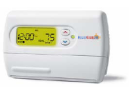

PowerCentsDC™ pilot
Tested customer response to dynamic pricing
  ~900 residential customers selected at random
  Three distinct dynamic pricing plans tested side by side
  Live billing July 2008 - October 2009
  Focus on low-income population
Facilitated by
  Advanced meters & two-way communications
  Enabling technologies (smart T-stats)
  Energy information feedback for customers
Pilot run by non-profit w/ broad stakeholder involvement
  * Utility * Regulator
  * Consumer advocates * Labor

Slide 6
PowerCentsDC participant response by rate plan
Participants on all 3 price plans reduced summer peaks in response to price signals
All customer segments responded
  Low-income response only slightly smaller
Higher price differentials led to greater peak
demand reductions
Findings generally consistent with other smart
metering pilots
Price Plan | Summer Peak Reduction | Winter Peak Reduction
CPP | 33% | 13%
CPR | 13% | (n/s)
HP | 4% | (n/s)

Slide 7
PowerCentsDC participant response: temperature & T-stat impacts
Customers reduced peak demand MORE at higher
temperatures (~double at 97° vs 85°)
Customers with smart thermostats had much higher peak reductions
Rate Group | No Smart Thermostat | With Smart Thermostat
R-CPP | 29% | 49%
R-CPR | 11% | 17%
AE-CPP | 22% | 51%
AE-CPR | 6% | 24%

Slide 8
PCDC participants liked dynamic pricing!
PCDC lessons-learned videos & Final Report available from www.powercentsdc.org

Slide 9
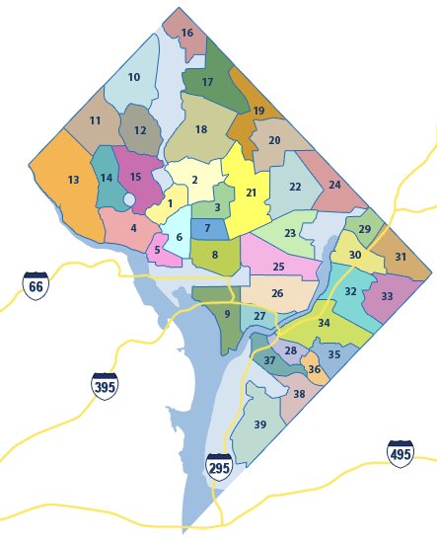
Implementation of AMI & dynamic pricing in DC
Pepco deployment of AMI underway
  Completion scheduled for early 2012
Customer education/engagement
AMI cost recovery
Generic proceeding exploring dynamic pricing options
  Pricing methods:, e.g. CPP, CPR/PTR, RTP
  Default pricing method; opt-in vs. opt-out; transition options
  Integration of dynamic pricing with default service procurement
  Third party access to customer data
  Cost & benefits of smart grid investments; performance metrics
Regional collaboration via MADRI:
  http://sites.energetics.com/MADRI/meetings_2011.html

Slide 10
Integrating dynamic pricing with wholesale markets
PJM’s price responsive demand (PRD) initiative
  Reduced capacity obligations for LSEs whose customers respond to retail price signals
  Savings require AMI & dynamic retail rates that reflect wholesale prices
  FERC filing pending fall 2011; rules effective 2012
Wholesale market incentives for PEVs
  Avoid 6 p.m. peak
  Potential compensation for storage, regulation svcs

Slide 11

Challenges for utility regulators
Due process requirements
Resource constraints (funding, expertise)
Pushback from stakeholders
  Diverse motivations
  Rate impacts
  Resistance to change
Institutional challenges
  Disconnect between wholesale & retail markets
  Coordination between 51 PUC jurisdictions
  Coordination with federal policies, initiatives
Finding a path forward….

Slide 12

Thank you!
Courtesy of SunPower Corporation

